Slide 1
JAVA ENGINEERING SHOWCASE
Fitbit Holistic Wellness Tracking System
Modular Java application architecture for real-time biometrics, workout logging, and health telemetry.
Core Java & MVC Architecture
Relational Persistence Layer
Robust Data Validation

Slide 2



SYSTEM ARCHITECTURE
Modular Object-Oriented Design
Domain Models
Business Logic Engine
Aggregation Services
Strictly typed entities for vitals, nutrition logs, sleep cycles, and user telemetry.
Deterministic calorie burn calculation, BMI indexing, and cycle projection algorithms.
Real-time daily rollups, goal deficit monitoring, and multi-stream health scoring.

Slide 3
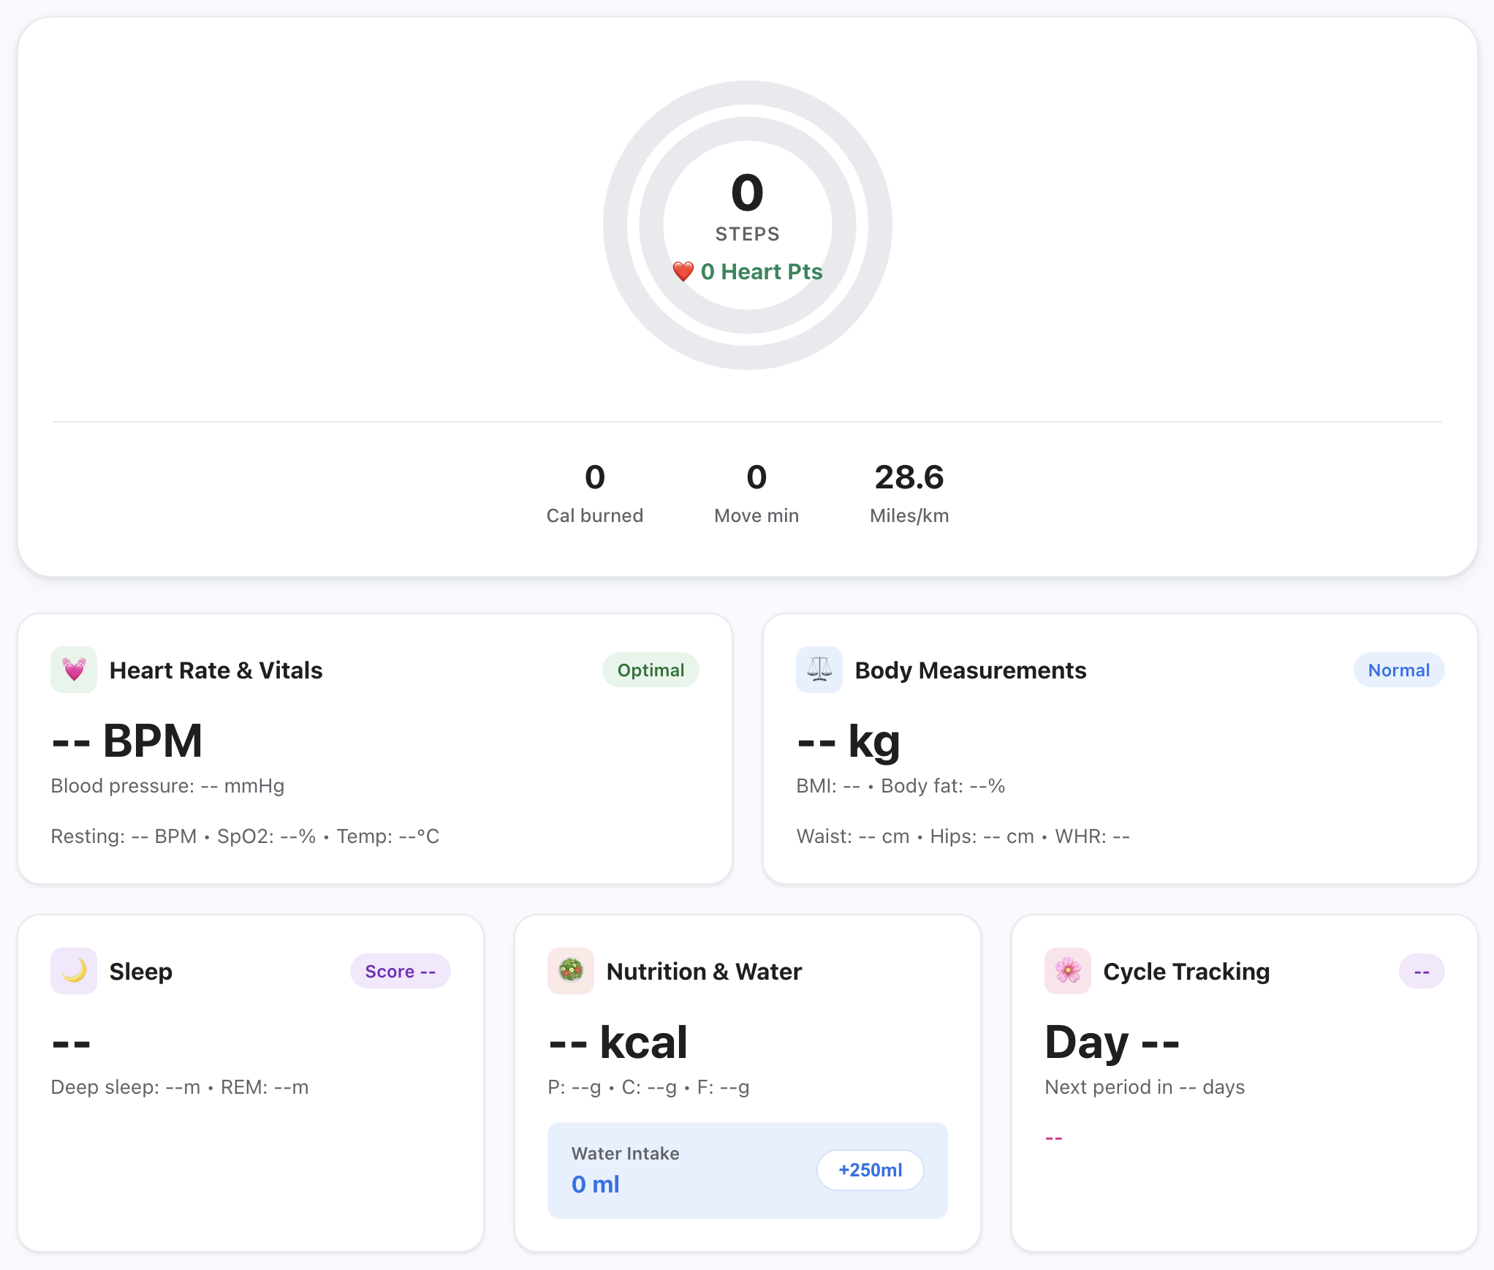



CENTRAL DASHBOARD
Real-Time Activity Telemetry
Activity Rings & Pacing
Instant calculation of steps, active minutes, and heart points.
Unified Health Glance
Consolidated overview across sleep, vitals, nutrition, and water.
Reactive Data Pipeline
Instant widget refresh upon workout or metric updates.

Slide 4
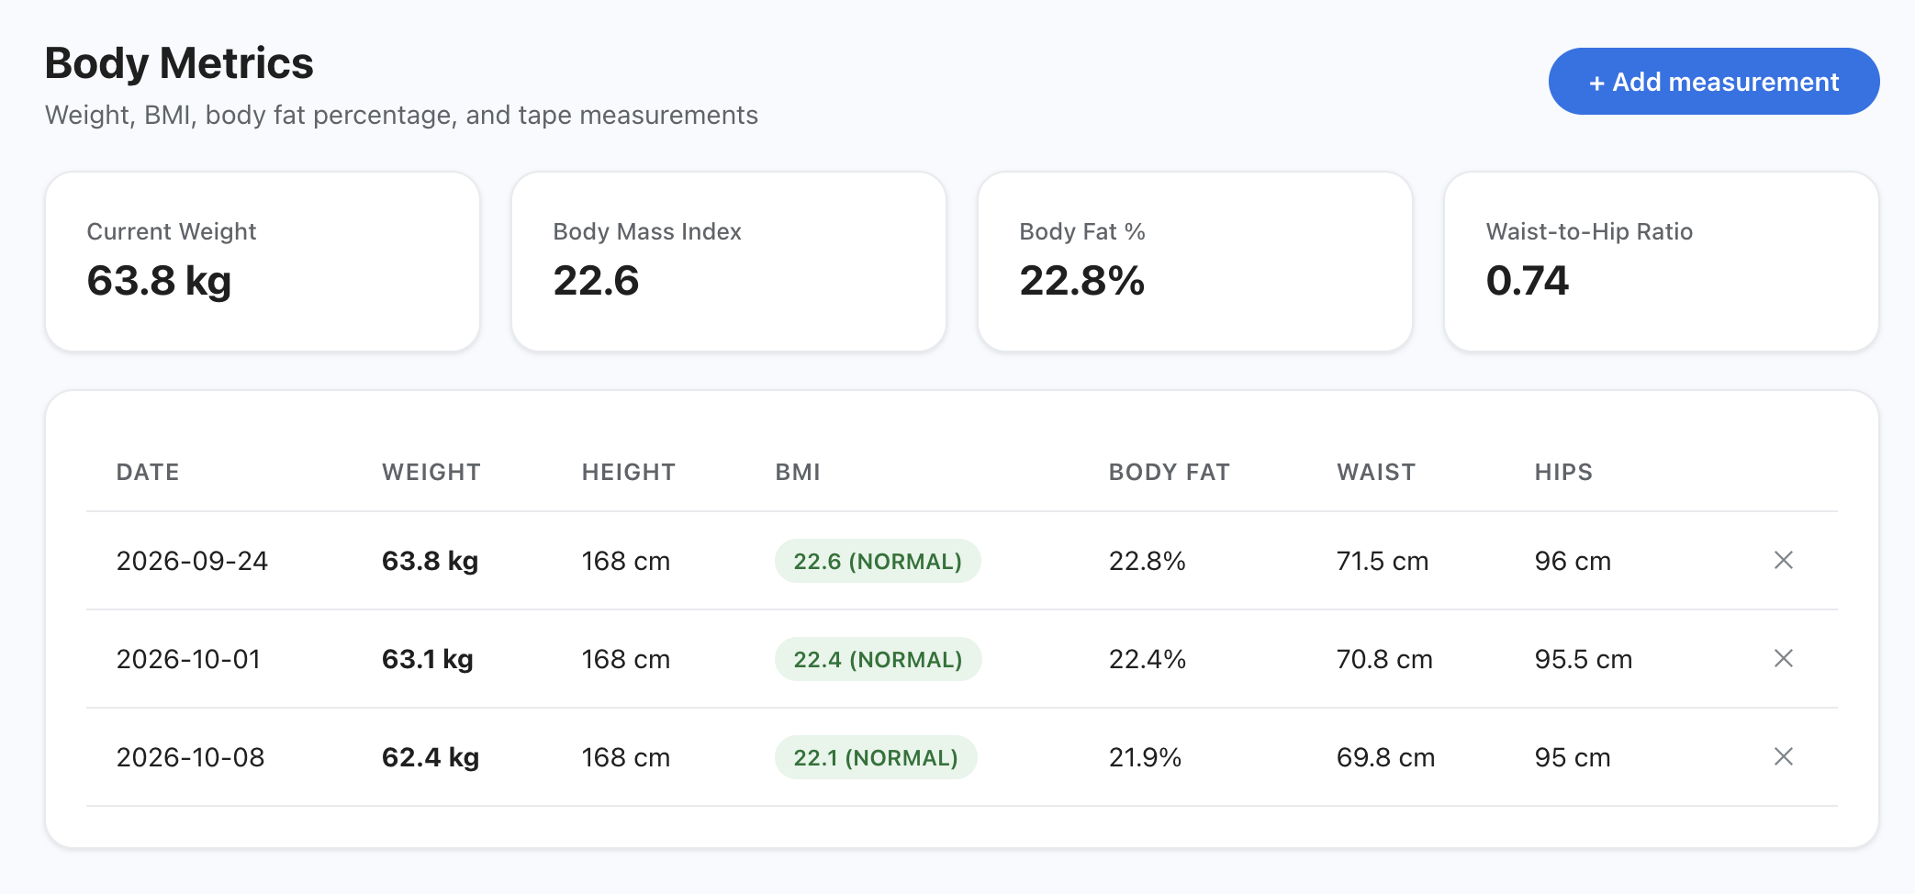
WORKOUT JOURNAL
Multi-Discipline Exercise Tracking
6+
100%
4 Levels
Workout modalities supported
Caloric burn precision formula
Intensity grading scale

Slide 5
BIOMETRICS ENGINE
Clinical-Grade Vitals Monitoring
Hemodynamic Monitoring
Oxygen & Metabolic Tracking
Anomaly Detection
Resting heart rate, active pulse, and systolic blood pressure.
Continuous SpO2 saturation and fast blood glucose readings.
Instant indicator badges for normal and out-of-range bounds.

Slide 6
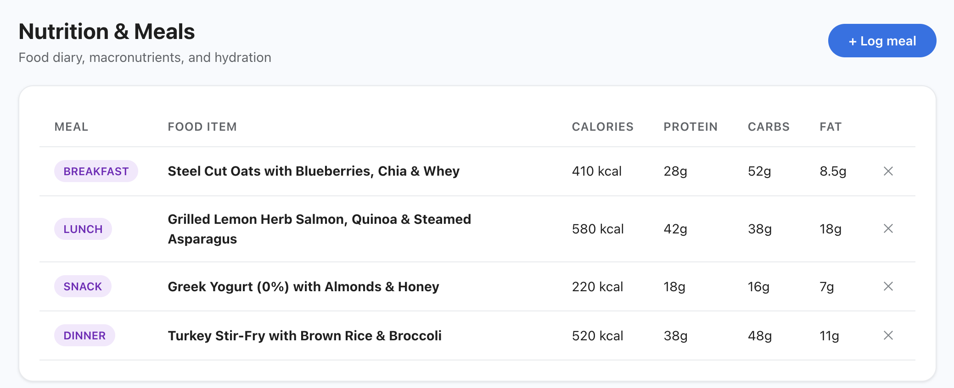
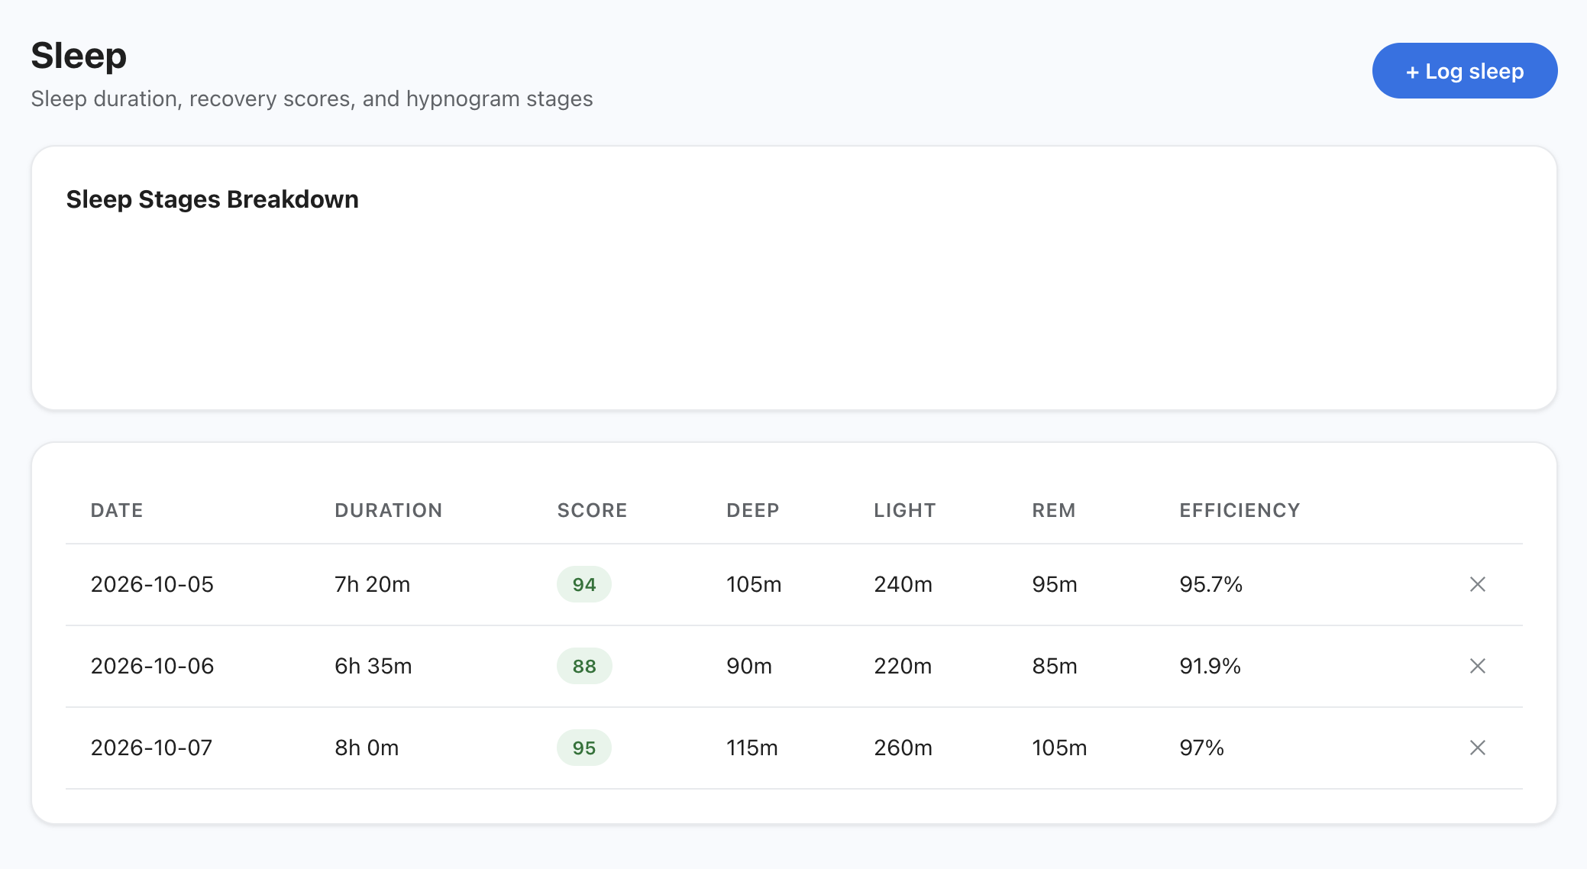
RECOVERY & FUEL
Dual-Stream Energy Management
Sleep Architecture
Rest Module
Macronutrient Tracking
Fuel Module
Detailed intake logs for protein, carbs, and fats categorized across breakfast, lunch, and dinner.
Hypnogram stage decomposition dividing deep, light, and REM intervals with efficiency scoring.

Slide 7

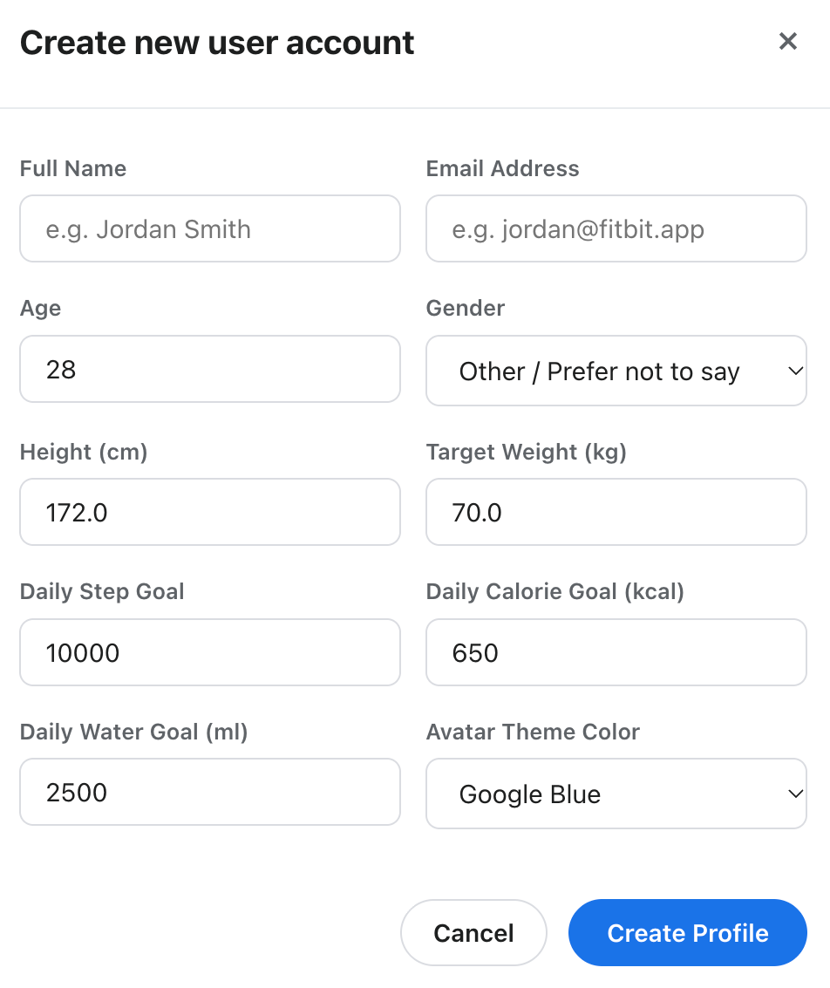
USER PERSONALIZATION
Custom Goal Engine & Onboarding
Personalized Biometric Baselines
Height, target weight, age, and gender-calibrated goals.
Daily Target Thresholds
10,000 steps, caloric caps, and 2500ml hydration targets.
Thematic UI Customization
User avatar accents and dynamic Google Blue theme themes.

Slide 8



HOLISTIC TRACKING
Advanced Body & Cycle Telemetry
Body Composition
Cycle Phase Forecasting
Automatic calculation of BMI and body fat percentages.
Follicular and luteal phase timeline predictions.
Anthropometric Logs
Symptom & Mood Journal
Tape measurements including waist and hip circumferences.
Qualitative energy ratings paired with quantitative stats.

Slide 9
TECHNICAL IMPACT
Engineering Highlights
7+
0ms
100%
Integrated health modules
In-memory aggregation lag
Deterministic data flow

Slide 10

Thank You
Fitbit Health Tracker — Designed and engineered in Java with clean object-oriented architecture.
Questions & Discussion

